Slide 1
Entwicklung einer Digital Twin-Applikation für einen Industrieroboter mit ROS und OPC-UA
Ahmed Ibrahim Almohamed
ibraah0@thu.de

Slide 2
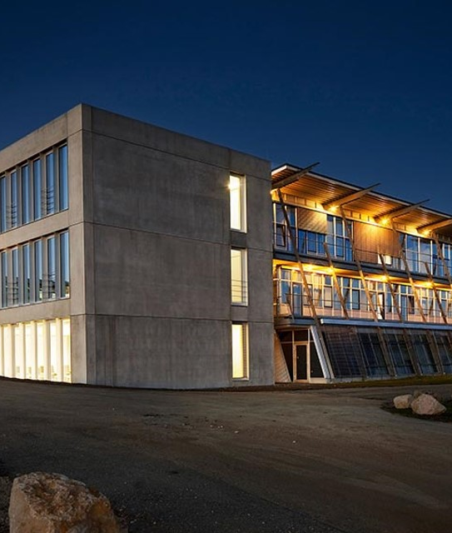
Agenda
Technical Foundations
State of Art
Demo

Slide 3
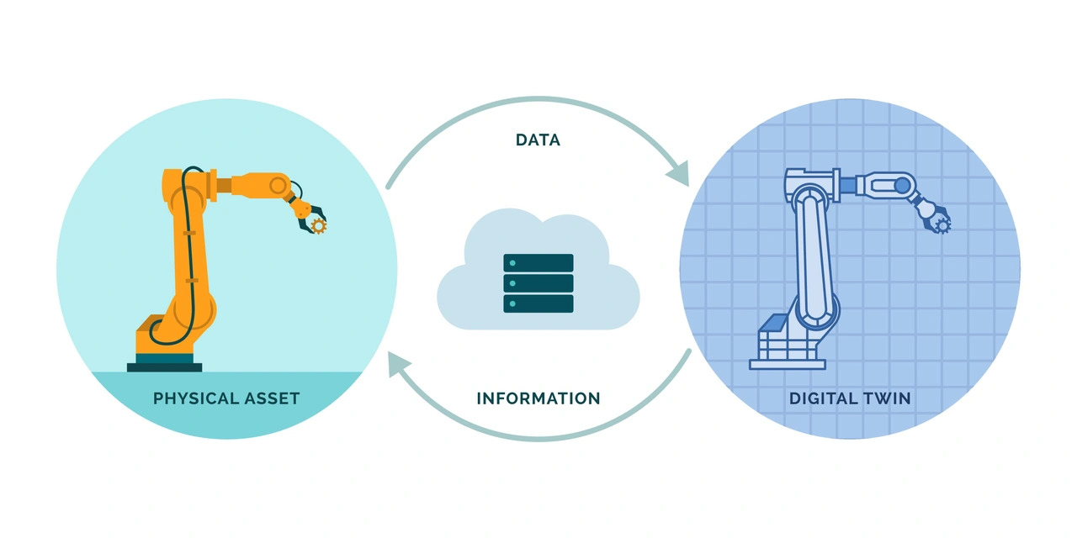
Technical Foundations
Digital Twin
Notes:
What is a DT ?
represents the creation of a virtual replica of a physical object or system that is used to simulate, monitor, and optimize its real-world counterpart.

Slide 4
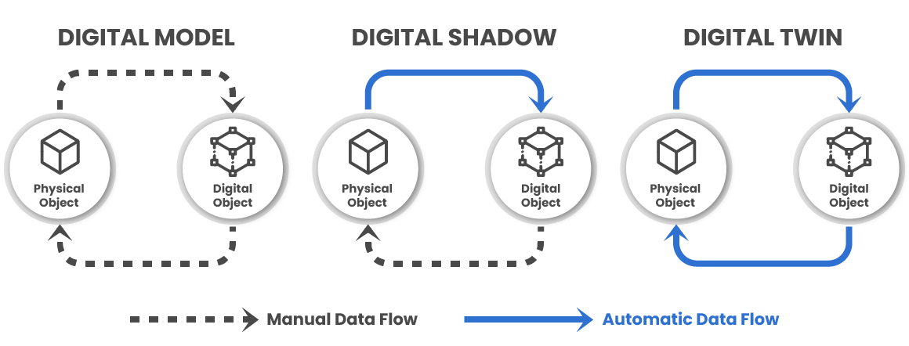
Technical Foundations
Level of Integration
Notes:
Layers of integration :
Mirroring or Digital Model : Digital representation of a physical entity
Digital Shadow : Physical to virtual uni-directional information flow
Digital Twin : virtual to physical bi-directional information flow

Slide 5
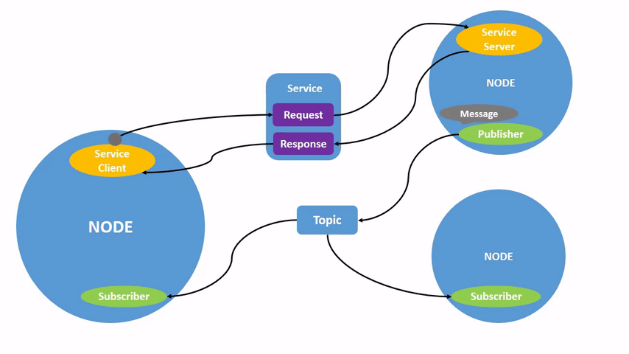
Technical Foundations
ROS2 Nodes
Notes:
ROS2 Nodes :
A node is a participant in the ROS 2 graph, which uses a client library to communicate with other nodes. Nodes can communicate with other nodes within the same process, in a different process, or on a different machine. Nodes are typically the unit of computation in a ROS graph; each node should do one logical thing.
Nodes can publish to named topics to deliver data to other nodes, or subscribe to named topics to get data from other nodes. They can also act as a service client to have another node perform a computation on their behalf, or as a service server to provide functionality to other nodes.

Slide 6
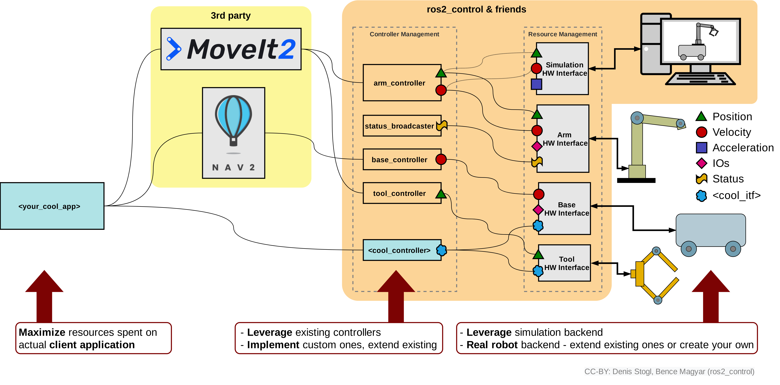
Technical Foundations
ROS2 Robotics Workflow
Notes:
ROS2 Layers :
App Layer : where the high level commands come ( RVIZ or some ros2 node )
3rd party software : like Movit2 for motion planning, manipulation, 3D perception, kinematics, control, and navigation.
Controllers

Slide 7
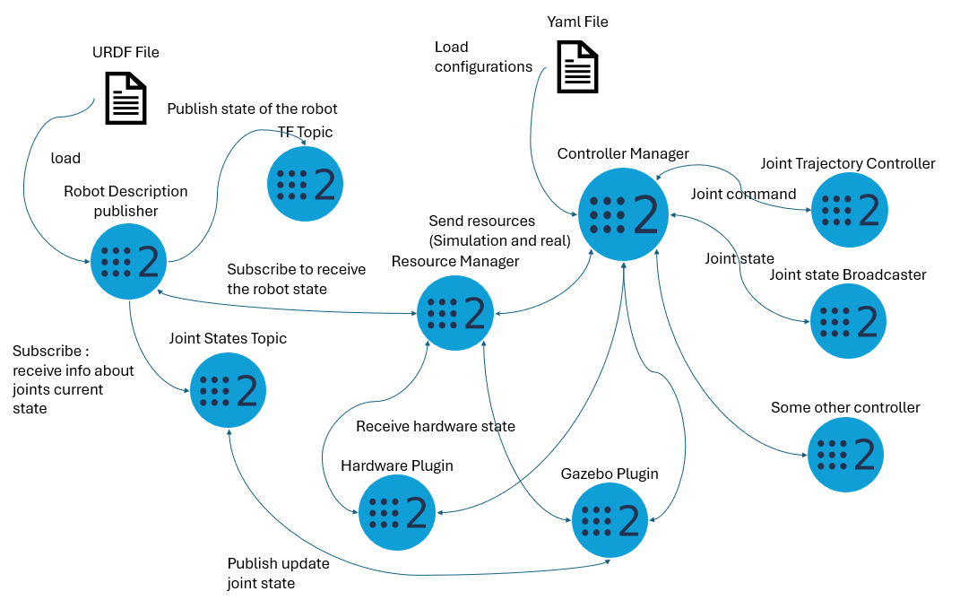
Technical Foundations
How dose it work ?
Notes:
This diagram gives a clear high-level view of how different components in a ROS 2 system interact, particularly focusing on the flow of information between hardware, the robot's state, and controllers.

Slide 8
Technical Foundations
Notes:
URDF File:
The robot’s kinematic model is loaded from a URDF file.
The Robot Description Publisher uses this model to publish the state of the robot, including transforms between its parts, to the TF topic.
Joint States Topic:
Used to receive the current state of the robot’s joints, including position, velocity, and effort.
The Robot Description Publisher subscribes to this topic to update the robot’s state and publish it to TF.

Slide 9
Technical Foundations
Notes:
Resource Manager:
Manages both simulation and real hardware resources.
Sends hardware state (either from real or simulated resources) to the Controller Manager.
Receives joint states from the Hardware Plugin or Gazebo Plugin.
YAML File:
Configuration file loaded by the Controller Manager to configure the controllers for the robot.

Slide 10
Technical Foundations
Notes:
Controller Manager:
Manages robot controllers (e.g., Joint Trajectory Controller, Joint State Broadcaster).
Sends joint commands to either the Hardware Plugin (for real hardware) or the Gazebo Plugin (for simulated hardware).
Receives joint states from the controllers and broadcasts them.
Hardware Plugin:
Interfaces with the real robot hardware.
Publishes the hardware state (joint positions, velocities, etc.) to the Joint States Topic.
Gazebo Plugin:
Acts as a simulated hardware interface for the Gazebo simulation environment.
Similar to the hardware plugin, it publishes joint states from the simulated robot to the

Slide 11
Technical Foundations
Notes:
Controllers:
Joint Trajectory Controller: Handles joint movement commands, sending them to the hardware (real or simulated).
Joint State Broadcaster: Publishes the current joint states.
Other controllers (like a PID controller or custom controllers) can also be added.

Slide 12
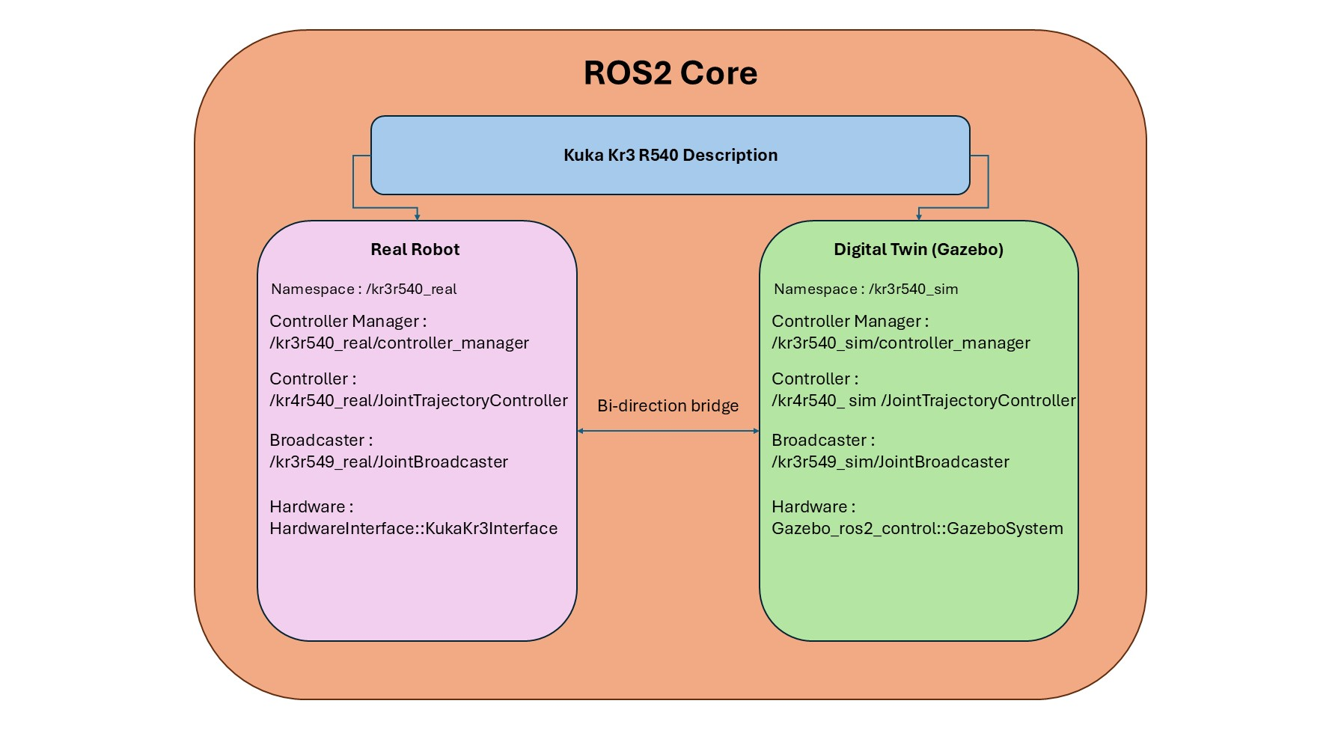
Technical Foundations
Using Namespaces
Notes:
In ROS 2, simulations and real robots are inherently treated as separate entities. They each operate with their own set of controllers and hardware interfaces, tailored to their specific environments. The simulated robot typically utilizes virtual hardware interfaces provided by simulation tools like Gazebo, while the real robot relies on physical hardware interfaces to interact with actual sensors and actuators.
This separation means that, by default, they do not share controllers or resources. As a result, integrating them into a cohesive system where they can reflect each other's states or behaviors becomes challenging. This poses a significant obstacle when attempting to create applications like digital twins where synchronization between the real and simulated environments is crucial.

Slide 13
State of Art
Digital Twin Overview
DONE
Notes:
Layers of integration :
Mirroring or Digital Model : Digital representation of a physical entity
Digital Shadow : Physical to virtual uni-directional information flow
Digital Twin : virtual to physical bi-directional information flow

Slide 14
State of Art
Digital Twin Overview
DOING
Notes:
Layers of integration :
Mirroring or Digital Model : Digital representation of a physical entity
Digital Shadow : Physical to virtual uni-directional information flow
Digital Twin : virtual to physical bi-directional information flow

Slide 15
State of Art
TBD planned to DONE on 31.10
Digital Twin Overview
Notes:
Layers of integration :
Mirroring or Digital Model : Digital representation of a physical entity
Digital Shadow : Physical to virtual uni-directional information flow
Digital Twin : virtual to physical bi-directional information flow

Slide 16
State of Art
Environment Setup
Ros2 package tree and implementation
Ros2 OPCUA Bridge
OPCUA Server and Database
KukaVarProxy Experimental Hardware communication
Dashboard
New system Roadmap
Notes:
System overview :

Slide 17
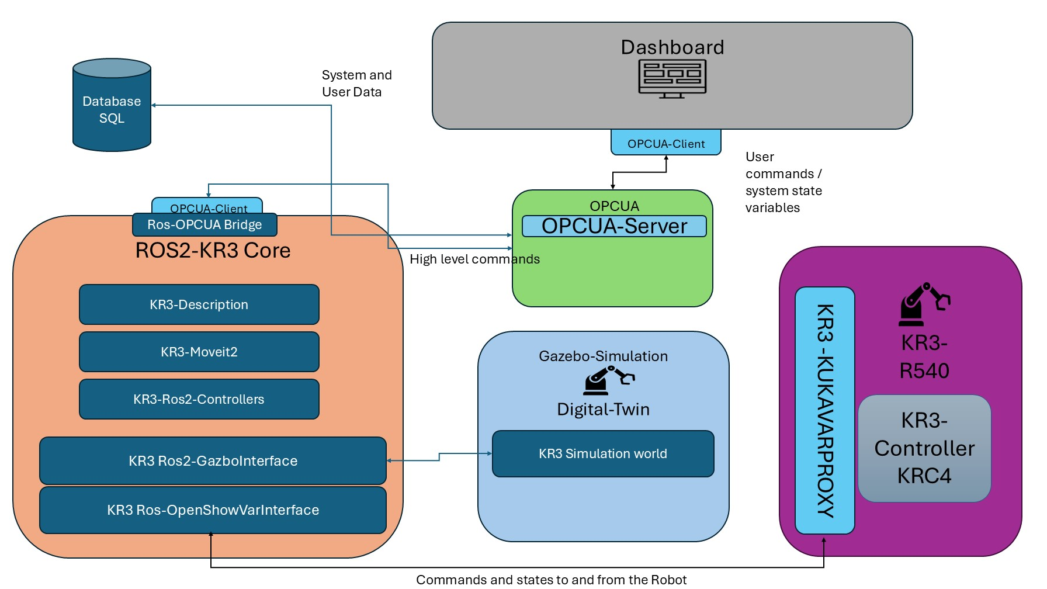
Roadmap
Ubuntu Dual Boot
Created a Shell script to Automate the ROS2 build
Enabled HMI mirroring with the lab’s PC (both OS)
Enabled a shared driver between the Robot and the lab’s PC
Installed the KukaVarProxyServer on the robot
Environment Setup
Ros2 package tree and implementation
Ros2 OPCUA Bridge
OPCUA Server and Database
KukaVarProxy Experimental Hardware communication
Dashboard
Notes:
System overview :

Slide 18
Roadmap
Environment Setup
Ros2 package tree and implementation
Ros2 OPCUA Bridge
OPCUA Server and Database
KukaVarProxy Experimental Hardware communication
Dashboard
Added a KRL script to move the robot with help of a custom global variable.
Created a KukaClient library in C++ to act as a client of the KukaVarProxy
Tested the KukaClient library
Notes:
System overview :

Slide 19
Roadmap
Environment Setup
Ros2 package tree and implementation
Ros2 OPCUA Bridge
OPCUA Server and Database
KukaVarProxy Experimental Hardware communication
Dashboard
Create a ros2 project with the new system packages (Done)
Implement the new system packages (Done)
Using Gazebo Ignition (Done)
Integrate the Tcp Client into the ROS2 (Doing)
Sync the Real Hardware with the Simulation (TBD until 31.10)
Notes:
System overview :

Slide 20
DEMO

Slide 21
Vielen Dank für Ihre Aufmerksamkeit.
www.thu.de

